Slide 1

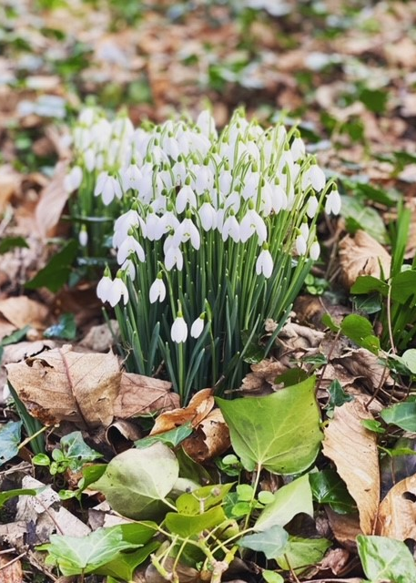
Mindfulness
PC Natasha Hill
Wellbeing Practitioner with Devon and Cornwall Police

Slide 2
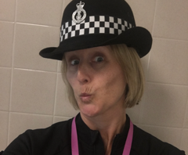

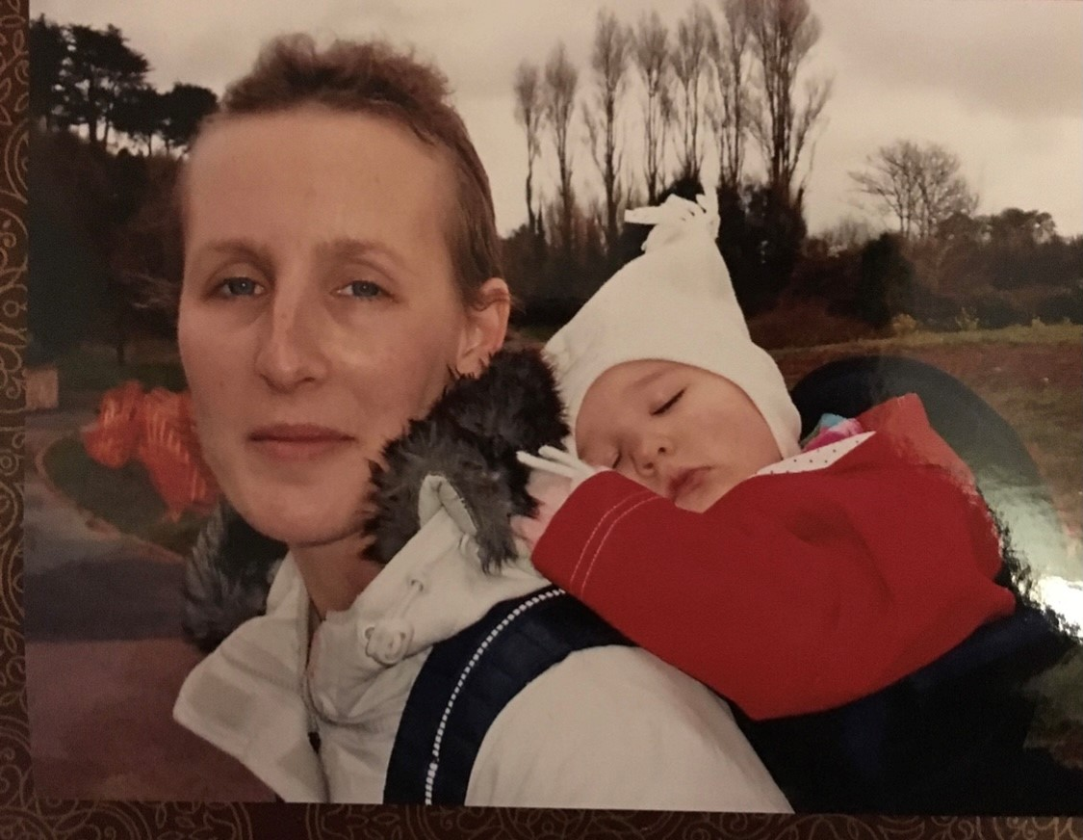



My Personal Journey

Slide 3
What is Mindfulness?
MINDFULNESS IS AN AWARENESS THAT EMERGES NATURALLY, WHEN WE PAY ATTENTION IN A PARTICULAR WAY, ON PURPOSE, IN THE PRESENT MOMENT AND WITHOUT JUDGEMENT.
-JON KABAT-ZINN, PHD.
FOUNDER OF Mindfulness Based Stress Reduction

Slide 4
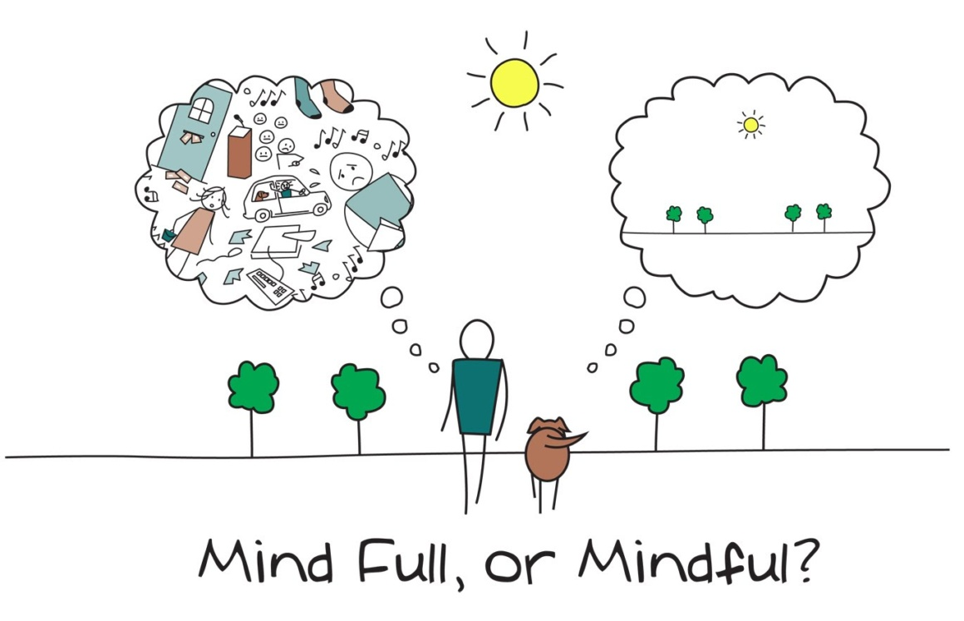

Slide 5
Mindfulness is not:
Emptying the mind
Achieving a state of bliss
The absence of thought
Religious

Slide 6
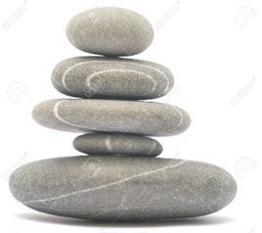
Live Life Mindfully
Living in the here and now helps us
            Think more clearly
            Feel more calm
            Cope better
            Reduces stress & Anxiety
            Raises feelings of connection and compassion towards self and others

Slide 7
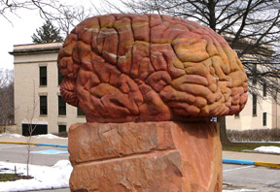

Slide 8
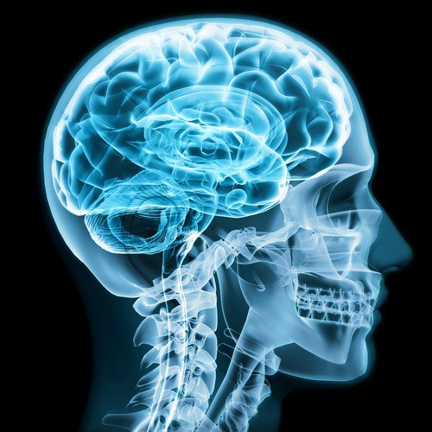

Slide 9
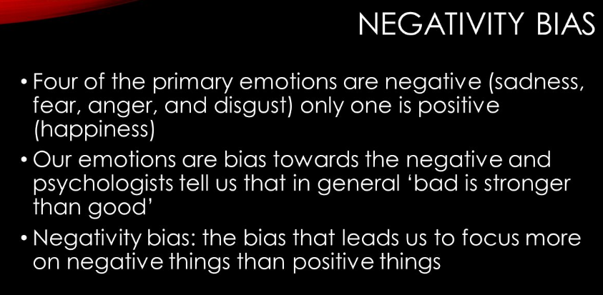
Notes:
Evolve to be fearful = Survive.

Slide 10
We therefore tend to:
Overestimate threats
Underestimate opportunities
Underestimate inner and outer resources.
We confirm these by ignoring, devaluing or altering our thoughts.
We end up with views of ourselves, others and the world that are ignorant, selective and distorted.

Slide 11
Creating Good Habits
Brushing your teeth
In the shower
Meal times
Exercising

Slide 12
Resources
Apps – Headspace/Calm/Buddify/Samten
Mindfulness a Practical Guide to finding peace in a frantic world by Danny Penman and Mark Williams
Netflix & You Tube

Slide 13
There is no perfect way to be mindful.
Just do it.
Start again and again and again

Slide 14
Mindfulness Exercises
Body Scan
Three Step Breathing Space
Focus on your breath
Let's give it a try……

Slide 15
Thank you & Any Questions?

