Slide 1
Sleep and fatigue in policing
Oscar Kilo – National Police Wellbeing Service
Dr Yvonne Taylor
Chief Inspector lead for sleep and fatigue

Slide 2
Sleep and fatigue in policing
Why is sleep important in wellbeing
What do we know about sleep and safety
What is the National Police Wellbeing Service all about
Sleep studies and ambitions

Slide 3
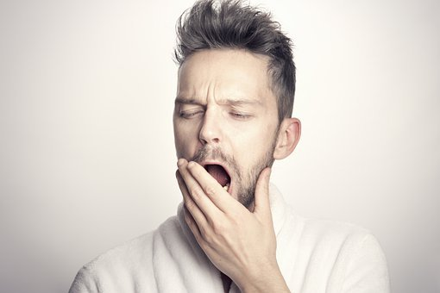
What is healthy sleep?
Duration
Timing
Continuity
Why are we tired?
Lifestyle
Physical
Psychological

Slide 4
Sleepiness and safety
Sleepiness peaks are generally around 0300-0500 and 1400-1600 (Increases in fatigue related road traffic collisions between these times)
More than 3.5 million shift workers in the UK
Shift Work induced fatigue is a significant risk factor increasing likelihood of accident and injury – fatigue accounts for up to 20% of serious RTCs on motorways / monotonous
Policing is associated with high prevalence of sleep disorders and self reported drowsy driving

Slide 5
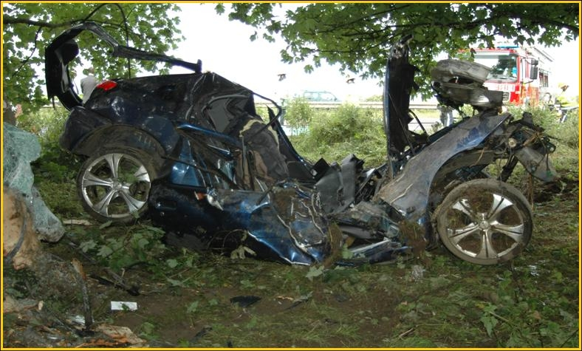

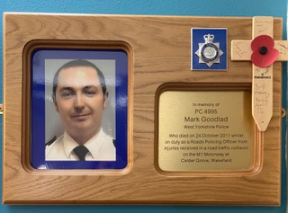
Why study sleep and driver fatigue?

Slide 6
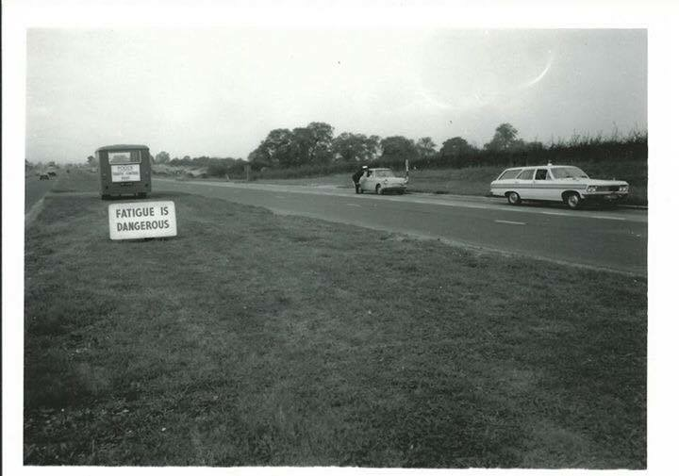
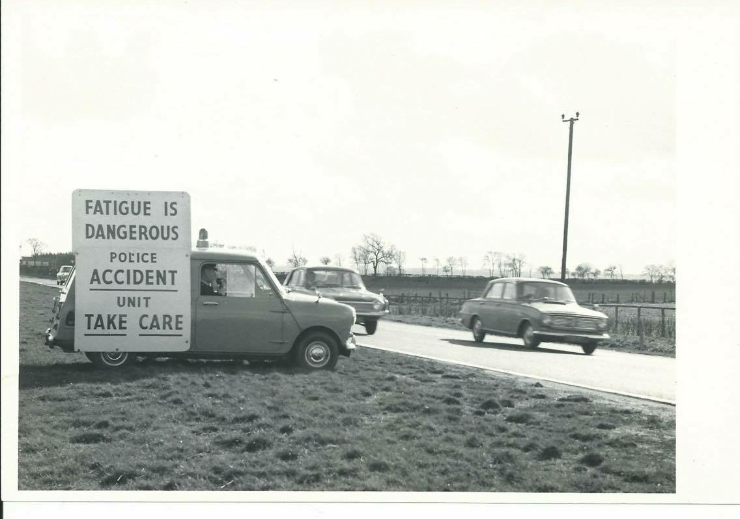
What has changed?

Slide 7
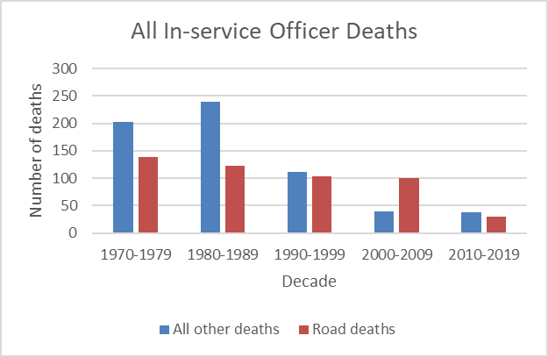
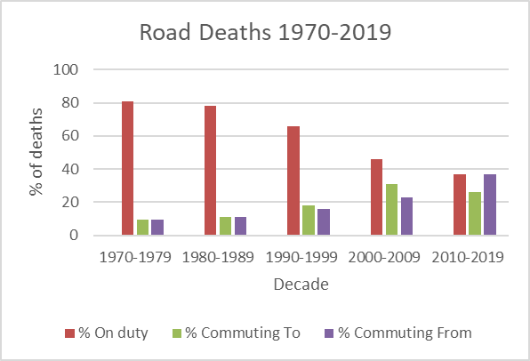
Line of duty road deaths

Slide 8
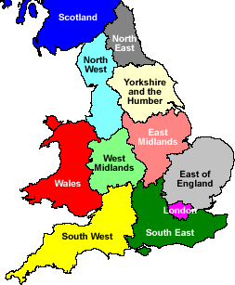
YaTH study
In the 12 months preceding the study, 6% involved in RTC / road departure on the way to or from work
52% involved in a ‘near miss’ such as a kerb strike, lane departure or almost had an RTC
96% of these incidents happened on the way home from work
62% had been working a nightshift prior to the incident
Questionnaire

Slide 9
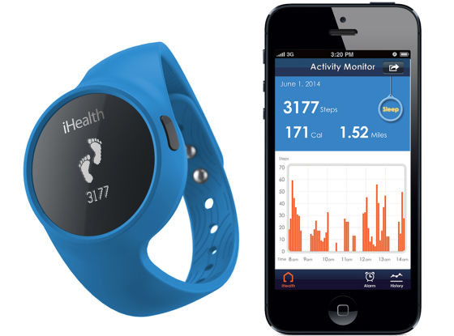
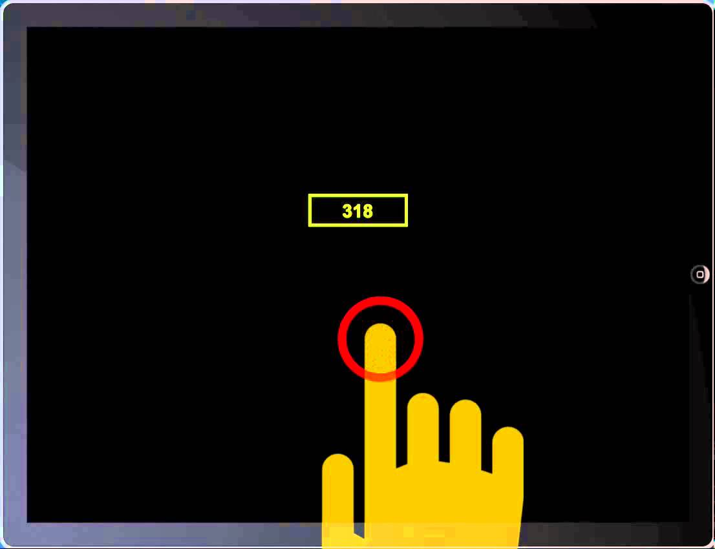
NYP study
Sleep and cognitive performance measurement

Slide 10
Shift patterns for wellbeing
Most effective and efficient shift patterns are 2x2x2 or 5 week VSA
Shift length should ideally be 8-10 hours
12 hour shifts are not recommended
Shifts should be forward rotating
Ideally, there should be no more than 6 shifts before rest days
Ideally, there should be no more than 4 consecutive night shifts
Day shifts should start as late as possible, i.e. 0700, rather than 0600 hrs
Rest days should be in blocks of no less than 2 consecutive days
Easily predictable patterns are generally considered positively

Slide 11

About NPWS
The National Police Wellbeing Service was launched in 2019 to provide support and guidance for police forces across England and Wales to improve and build organisational wellbeing.
It is an evidence based, sector specific service offering. Developed for policing, by policing, it is designed to meet the unique needs of police forces, officers and staff

Slide 12
Our ambition
Our ambition is for all people who work in policing to understand how to build personal resilience, feel confident they can speak up when things aren’t going well, and to get the best personalised support possible when they do

Slide 13
Working closely with College of Policing, the National Police Chiefs’ Council and the Home Office, we want to:
Help police forces build world–class wellbeing support for everyone who works for them
Improve knowledge and understanding of help and support available
Reduce stigma around seeking support or help
Encourage people to support themselves and realise their own potential
Improve personal resilience and self-help skills

Slide 14











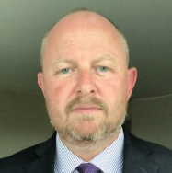
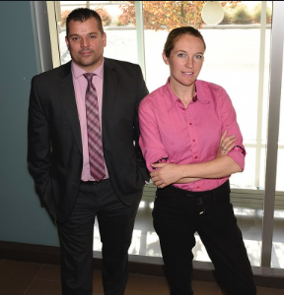










Creating academic partners and networks
Sleep and Fatigue Research

Slide 15
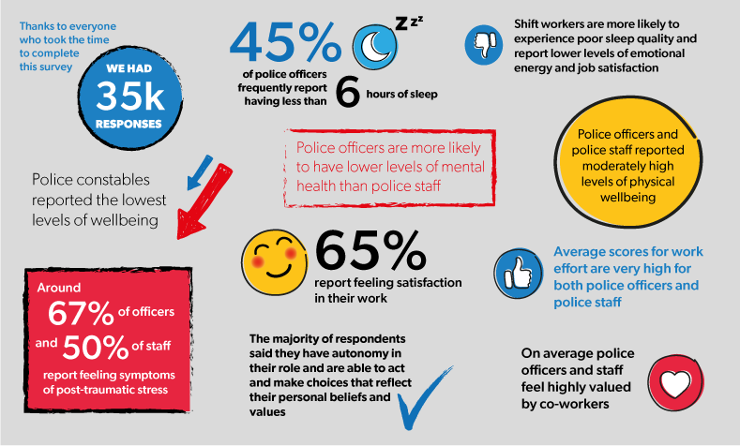
National Police Wellbeing Survey findings – 2019

Slide 16
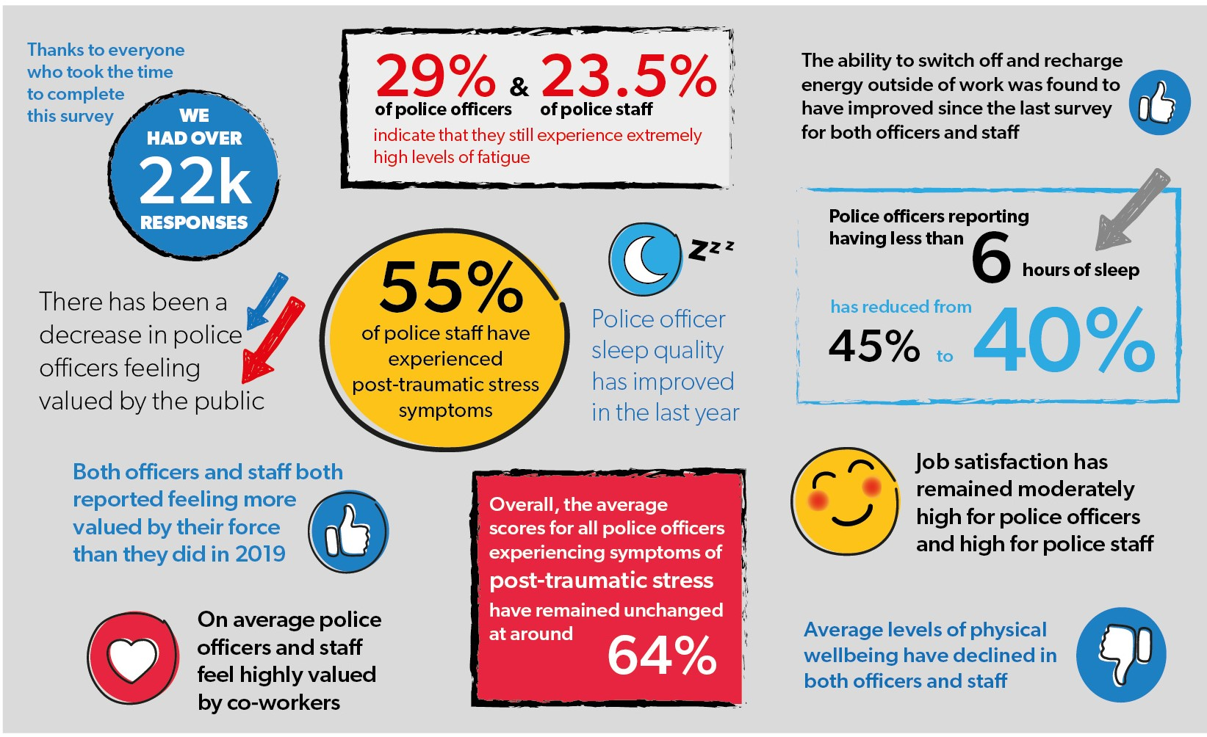
National Police Wellbeing Survey findings – 2020

Slide 17
National Police Wellbeing Survey findings – 2021

Slide 18

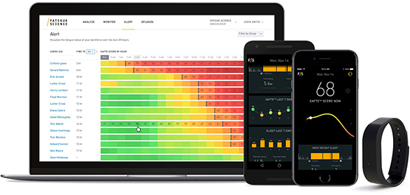
WSU - Fatigue and shift working risk management strategy

Slide 19

University of Surrey

Slide 20


Dr Sophie Bostock

Slide 21
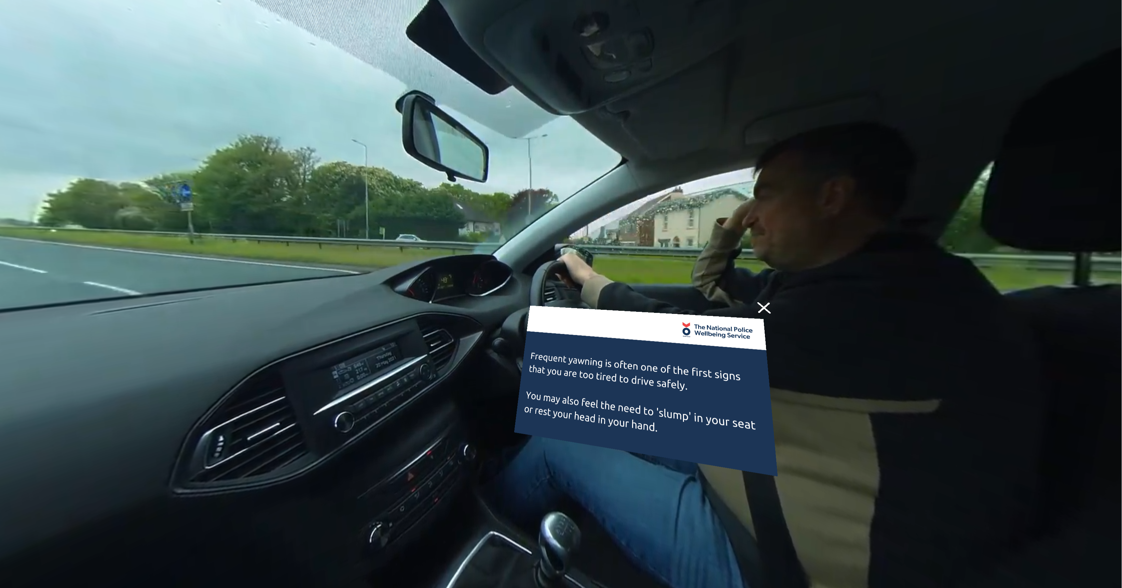

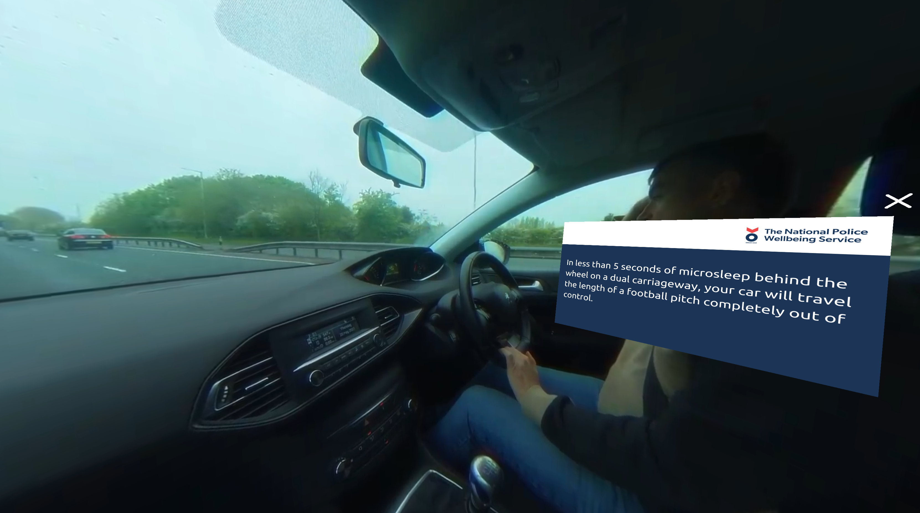
ViRTi

Slide 22
Fatigue considerations
A fatigued driver is less alert, less able to process information and will have slower reaction times (Folkhard, et al, 2005)
The only cure for sleepiness is sleep! (Lansing, 2010)
Nightshift work is associated with an increased number of sleep disorders, mental health problems, frequency of cardiovascular and gastrointestinal disease (Muecke, 2005)
Education of both employers and employees is of primary importance, we need to work together (Alford, 2009)

Slide 23
Any questions?
Yvonne.taylor@college.police.uk
More information:
Twitter: @OscarKiloUK
LinkedIn & YouTube: Oscar Kilo UK
Web: www.oscarkilo.org.uk

