Slide 1

THIS IS MY STORY OF PTSD

Slide 2

THIS IS MY STORY OF PTSD
JO WARD

Slide 3
THE SCENE
2006 – attended a Murder Scene
Female –throat cut by her ex partner
Scene – living room – wooden flooring
Initial feelings/thoughts
First signs

Slide 4
SYMPTONS
Nausea
Panic attacks
Fear
Flashbacks
Unable to sleep/switch off
Dark thoughts
Emotional
Anxiety/depression
Feeling of hopelessness
Black hole – no light
Feeling of going mad

Slide 5
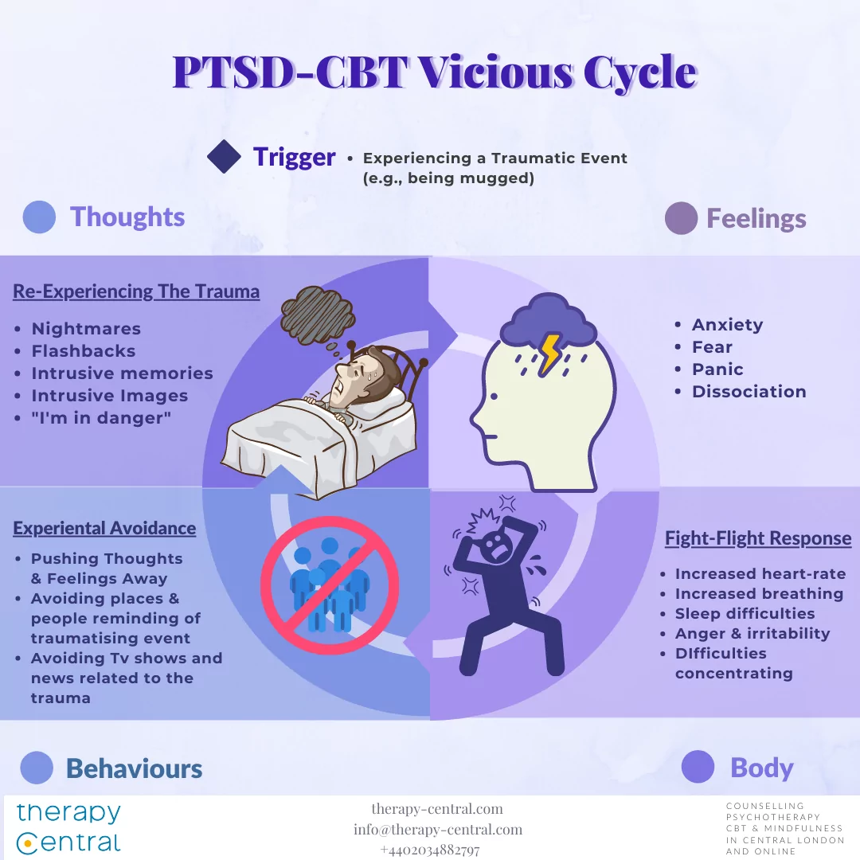

Slide 6
MY JOURNEY
Recognise & inform SIO
Taken off case – unable to deal
Referred to Occ health
GP
Home life – impact
Work – Manager at time
Medication
Talking to Professionals

Slide 7
MY RECOVERY
Acceptance/honesty
Positivity
Talking
Sharing my experience
Medication
Facing fears
Monitoring my own stress levels/workload
Exercise

Slide 8
ME - NOW
I survived !!
I help colleagues going through similar
Recognise signs of colleagues experiencing PTSD
Aware of my own limitations
Put things into place to avoid it happening again
Have strategies if things start to effect me
Never get personally involved in a job – concentrate on the end goal

Slide 9

YOUR NOT MAD
YOUR IN TRAUMA

Slide 10
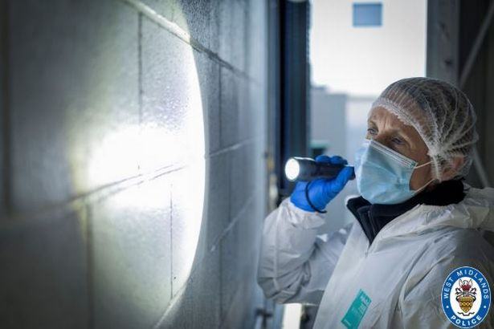

Slide 11
ANY QUESTIONS ?

