Slide 1
Building Resilience for Employees in Trauma Exposed Roles
Dr Noreen Tehrani
www.noreentehrani.com

Slide 2
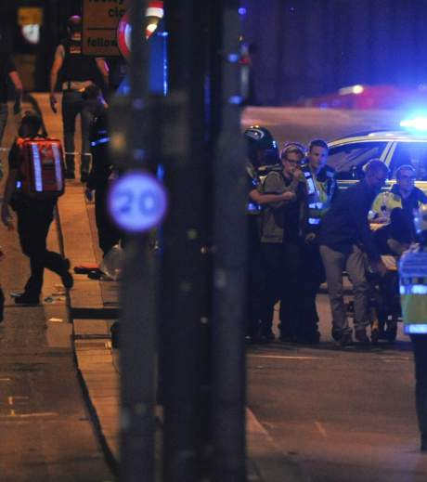
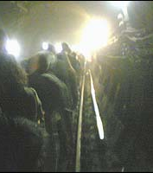

Slide 3
Not all injuries are visible
Stress
Compassion fatigue
Burnout
Secondary trauma
Post Traumatic Stress
Complex PTSD

Slide 4
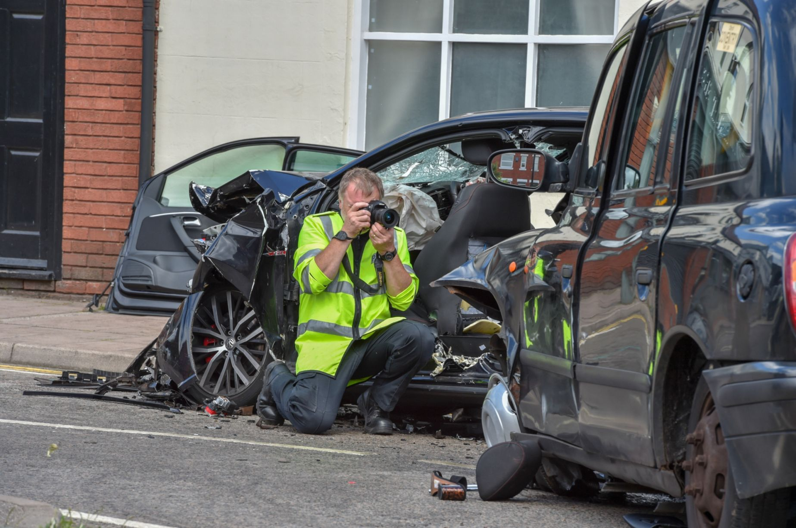
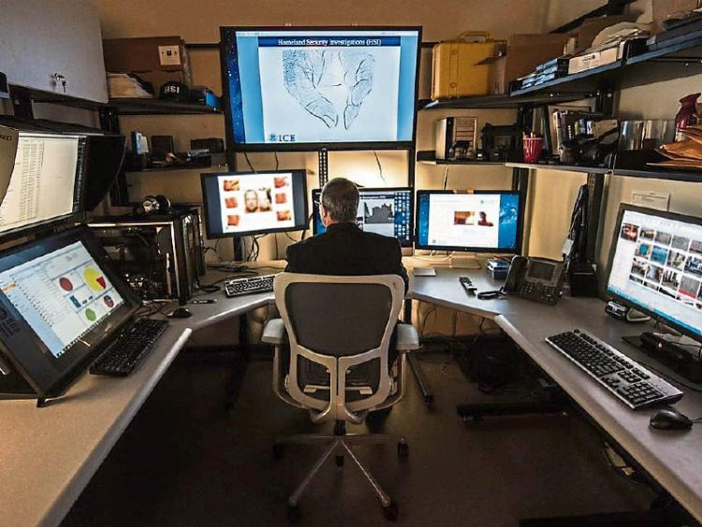

Slide 5
Comparison between police staff and officer roles
Symptoms | Police Staff Roles |  |  |  | Police Officer Roles |  |  |  | Public
 | DFT (n=597) | CSI (n=696) | SCIU/FCIU (n=1106) | OHA (n=127) | POLIT /ICAT (n=961) | Child Abuse (n=5461) | ViSOR (n=539) | Negotiators (n=2546)
Anxiety | 25% | 29% | 35% | 25% | 21% | 21% | 16% | 19% | 3.5%
Depression | 33% | 34% | 38% | 31% | 25% | 25% | 21% | 23% | 8-12%
PTSD | 8% | 10% | 13% | 17% | 6% | 8% | 4% | 6% | 3%
Burnout | 15% | 21% | 23% | 19% | 17% | 15% | 15% | 22% | NA
Secondary Trauma | 16% | 25% | 33% | 11% | 13% | 15% | 12% | 15% | NA
Notes:
Tell: This slide shows the numbers of officers and staff who have marginal or clinical levels of symptoms in a number of high risk roles. As you can see the officers in one of the roles have much lower levels of symptoms than found in other roles.
Can you think of some reasons for these results?
Firearms officers have asked to do this work and don’t want to move into a different role. There may still be a stigma related to MH conditions as they would lose their firearms ticket if they were found to have PTSD.
Also the pattern of symptoms is different i.e. Collision Investigators have higher levels of primary trauma and FLOs higher levels of secondary trauma

Slide 6
Anxiety & Depression Symptoms
Anxiety
Depression
Restlessness or feeling keyed up or on edge.
Easily fatigued
Difficulty in concentrating or mind going blank
Irritability
Muscle tension
Sleep disturbance - difficulty in falling or staying asleep or unsatisfactory sleep
Depressed mood
Lack of interest or pleasure in, activities
Significant weight loss or weight gain
Insomnia or hypersomnia
Physical agitation or lethargy
Fatigue or loss of energy
Feeling worthlessness or
Experiencing inappropriate guilt or shame
Difficulty in thinking or concentrating
Recurrent thoughts of death or suicide
Notes:
Explain: this slide shows the difference between anxiety and depression. These are the clinical symptoms needed for a diagnosis. As you can see stress and anxiety are really the same thing. Depression is the feeling you get when you are unable to deal with the anxiety you are experiencing.
A few people may have a depressive personality – they are always depressed
Other people may suffer from bi-polar condition known as manic depression. These people shift between being overly optimistic to being extremely depressed.
People with these conditions are normally given medication to help them manage their symptoms.

Slide 7
Burnout & Compassion Fatigue Symptoms
Burnout
Compassion Fatigue
Emotional Exhaustion: Physical fatigue, emotionality, sleeping difficulties, loss of sense of humour
Depersonalisation: Inability to care about others, isolation, lack of identification, seeing others as sub-human
Feelings of incompetence: Loss of ambition/drive, no sense of future, feelings of being hopeless or helpless
Negative Thinking: Seeing others in negative light, a loss of trust in others, feeling cut-off isolated and alone
Increased compulsive behaviours: Using alcohol, caffeine, sex, gambling, computer games and spending for short term pleasure
Chronic Physical & Psychological problems: Colds, skin and digestive problems, nightmares, flashbacks ruminations about work problems

Slide 8
PTSD Symptoms
Re-experience (1 or more)
Intrusive memories
Distressing dreams
Flashbacks or feeling that the trauma is reoccurring
Intense distress when exposed to cues
Marked physiological responses to cues
Hyperarousal (2 or more)
Irritability/anger
Reckless and self destructive behaviour
Hyper-vigilance
Exaggerated startle
Problems with concentration
Sleeping difficulties
Negative thinking/mood (2 or more)
Inability to remember parts of trauma
Negative beliefs or expectations
Distorted thinking including blaming of self or others
Persistent negative affect and lack of positive emotions
Lack of interest in future
Feelings of detachment
Inability to feel positive emotions
Avoidance (1 or more)
Avoidance of distressing memories, thoughts or feelings about trauma
Avoidance of reminders e.g. People, places, objects that cause distress
Notes:
Explain: this slide shows the difference between anxiety and depression. These are the clinical symptoms needed for a diagnosis. As you can see stress and anxiety are really the same thing. Depression is the feeling you get when you are unable to deal with the anxiety you are experiencing.
A few people may have a depressive personality – they are always depressed
Other people may suffer from bi-polar condition known as manic depression. These people shift between being overly optimistic to being extremely depressed.
People with these conditions are normally given medication to help them manage their symptoms.

Slide 9
sound
smell
sight
taste
Pre-
frontal
cortex
Thalamus
Hippocampus
Amygdala
Fuse
Touch &
Body sensations

Slide 10
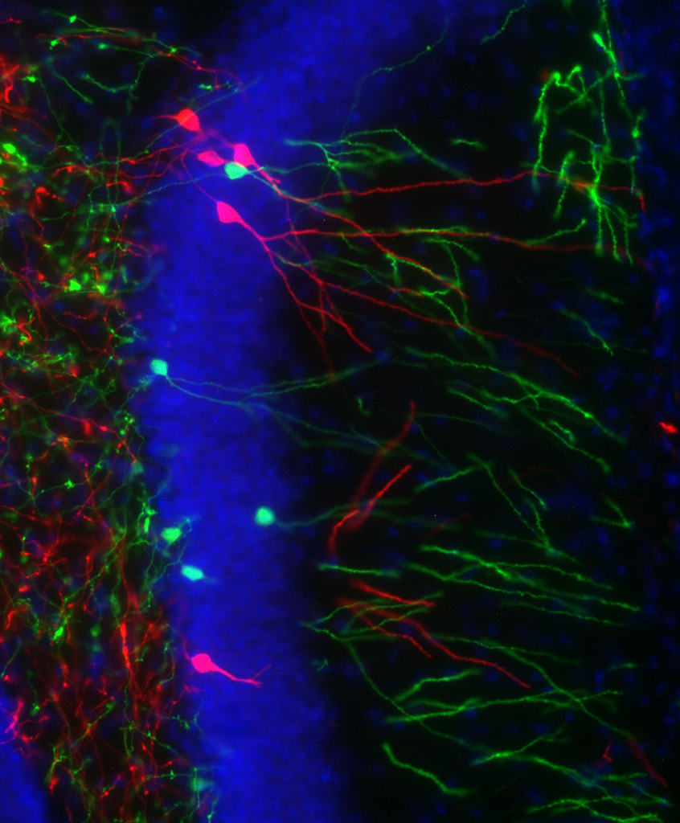
Blowing the fuse
Dis-regulation of arousal system
Inability to find the words
Poor memory
Re-experience
Dissociation

Slide 11
Compassion Fatigue
Found in professionals engaged in working with people or materials which are emotionally demanding
More common in people with high levels of emotional empathy
Associated with depression, emotional exhaustion, detachment and lack of enthusiasm for things that were once enjoyed

Slide 12
Secondary/ Vicarious Trauma
Exposure to traumatic images, stories or materials can create secondary or vicarious trauma
Visual Images
Auditory reports
Written accounts
Artefacts
People can be traumatised by their ability to imagine a traumatic event

Slide 13
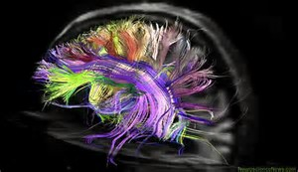
Neuronal Pathways in the Brain

Slide 14
What influences Secondary Trauma developing?
Imagination – being able to visualise the situation
Empathy – understanding how the victim would feel
Sensitivity – being of a sensitive personality
Familiarity – recognising something familiar
Exhaustion – reduction of personal resilience and hardiness

Slide 15
Secondary PTSD Symptoms
Re-experience
Unable to switch off from the work
Dreams, flashbacks of events experienced by others
Over-reactions to work related issues
Re-enacting aspects of victim behaviour
Arousal
Unreasonable irritability or anger focussed at family, colleagues or situations
Self destructive behaviour
Jumpy, inability to sleep or relax
Poor concentration leading to increased numbers of accidents or errors
Negative Cognitions
Negative self beliefs e.g. “I’m incompetent” “The world is bad” “No one can be trusted”
Lack of interest in things they used to enjoy
Negative outlook on life leading to unreasonable fears, beliefs and attitudes
Cutting themselves off from family, friends
Unable to show sensitivity or positive emotions
Avoidance
Putting off doing work or dealing with demanding cases
Lack of curiosity
Avoiding difficult or distressing work
Inability to recount or recall details
Notes:
Explain: this slide shows the difference between anxiety and depression. These are the clinical symptoms needed for a diagnosis. As you can see stress and anxiety are really the same thing. Depression is the feeling you get when you are unable to deal with the anxiety you are experiencing.
A few people may have a depressive personality – they are always depressed
Other people may suffer from bi-polar condition known as manic depression. These people shift between being overly optimistic to being extremely depressed.
People with these conditions are normally given medication to help them manage their symptoms.

Slide 16
Symptoms and Signs
Symptoms are what the person experiences
Signs are what can be observed by others
Common signs of psychological problems
Under performance
Moodiness
Short temper/irritability
Detachment
Eating problems
Tired
Jumpiness
Low motivation
Poor memory/forgetful
Minor accidents
A changed behaviour

Slide 17
Occupational health and surveillance
Organisation
Risk Assessment
What is needed
Design surveillance program
Competent persons
Implement the program
Act on results
Occupational health focuses on the protection and promotion of the health of workers by preventing and controlling occupational diseases and accidents. (WHO, 1994)
Occupational health surveillance refers to the regular or repeated collection, analysis, archiving, interpretation, and dissemination of occupational health-related data for monitoring the health of a workforce and individuals. (Freeman Colpe et al. 2010)
Notes:
I hope you don’t mind me restating what I believe you already know:
The role of Occupational health is to protect and promote the health and wellbeing of employees by preventing and controlling occupational diseases and accidents
Occupational Health surveillance is at the core of the work of an OH practitioner. The regular and repeated collection, analysis, interpretation and dissemination of Occupational Heath data for monitoring the health of the workforce.
Eyesight, hearing, lung function etc are important not only in protecting the employee but also customers and members of the public

Slide 18
How Psychometrics are used to improve public health
What are the differences between screening, surveillance and research?
Screening
Surveillance
Research
Screening is the active search or process of detection for disease or disorders among apparently healthy people.
Employs in average risk populations to stratify into higher and lower risk of disease
An individual’s health status is monitored and evaluated over time. To check for early signs of harm from work-related activity or work-related exposure which may put an employee at risk.
The objective of the surveillance is to rectify or eliminate the issue causing the work-related issue or exposure
The purpose of research is to develop generalizable knowledge to improve health. Generalizable knowledge means new information that has relevance beyond the population or program from which it was collected, or information that is added to the scientific literature.

Slide 19
The Aims of Health Surveillance
To eliminate occupational factors and conditions hazardous to health and safety at work.
To develop and promote healthy and safe work, working environments and organisations.
To enable workers to conduct socially and economically productive lives. (WHO, 1994)
Two separate areas for organisational focus:
Hazard Surveillance: identification, elimination, reduction and management of hazards
Health Surveillance: regular assessments of health in employees in order to identify evidence of ill health
Notes:
The aim of physical and psychological surveillance is to work to eliminate risk to health, safety and welfare at work.
The aim is to enable workers to work together constructively and to be economically productive so they and their organisations can thrive.
What is really important to recognise here is there are two separate but complementary approaches and goals
The first is to identify the causes of ill health through the identification of hazards with the goal of eliminating, reducing or minimising their impact
The second it to identify the clinical symptoms of ill-health and the adverse health effects of work

Slide 20
Psychological hazard
HSE Management Standards (Cousins, MacKay et al. 2004)
Demand, Control, Support, Relationships, Role, Change
Other Psychological Hazards:
Personal Factors shown to be hazardous
Frequency/intensity of traumatic exposure (Skeffington, Rees et al. 2017)
Adverse Childhood Experiences (Felitti et al 1998)
Neuroticism/rumination (Wild, Smith et al. 2016)
Avoidant coping style (Syed, Ashwick et al 2019)
Gender (Kline, Ciccone et al 2013)
Alcohol consumption (Syed, Ashwick et al 2019)
Education level (Brewin Andrews 2000)
Organisational Hazards
Mental Health Stigma (Halpern Gurevich et al 2009)
Poor leadership (Bartone 2006)
Lack of social support (Armstrong et al 2014)
Sense of Coherence (Antonovsky, 1979)
Notes:
There are many tools that can be used to measure psychological hazards one of the best known are the HSE Management Standards that were developed in Bootle by Colin MacKay’s team. This work was based on the Marmot Whitehall Study.
However, there are many other workplace hazards to psychosocial wellbeing, I have split these into two groups the personal hazards and those which are organisational.
Each of these hazards have been shown to have different levels of influence depending on the working culture and environment but the organisational hazards tend to have the greatest influence as they affect the largest number of people

Slide 21
Psychological health surveillance
Periodic clinical assessments of adverse health effects found in high risk groups providing opportunities for:
Early detection of symptoms of disease
The prompt introduction of preventative measures
Surveillance measures include identification of signs of ill health e.g.
Mental wellbeing reviews e.g. NICE: Mental Wellbeing at Work
Workability Assessments e.g. Finnish Institute of Occupational Health
Monitoring of Sickness absence e.g. CIPD Health and Wellbeing at work
Reviewing grievances, bullying/harassment, whistleblowing cases
Monitoring of medical retirements
Direct surveillance using clinical symptoms
Psychological self-report questionnaires
Clinical assessments by OH professionals & psychologists
Notes:
We now move to psychological health surveillance. It is important to undertake psychological surveillance where there are uncontrollable hazards as a way of detecting early signs and making sure that preventative measures are introduced
There are several ways in which psychological health surveillance can be achieved:
Some of the simpler tools for surveillance look for the signs of MH problems – these proxy indicators might include asking people how they are feeling or undertaking a general assessment of their attitudes towards their health and workability. It is also possible to use things like sickness absence measures, bullying and harassment claims and medical retirements.
Whilst signs are useful it may be important to identify if there is a diagnosable disease. This requires a measurement of actual disorders or conditions.
Psychological self report measure are an important first step but the Gold Standard is a clinical assessment by a qualified professional

Slide 22
Health Surveillance can:
Quantify the incidence and prevalence of work related disease
Indicate the presence or absence of a hazard
Assess the adequacy of control measures
Identify individuals at increased risk
Establish base-line symptom levels
Provide a benchmark for preventative action
Identify opportunities to improve health education
Evaluate the benefit of wellbeing interventions
IMPORTANT WARNING
Health surveillance does not predict the future and is not a cure
Notes:
Health surveillance is able to identify work related disease and hazards. It can establish whether control measures are working and identifies people at risk.
It is also good at establishing base-line levels and benchmarks for action
Identifies opportunities for preventative action and can evaluate interventions and the impact of organisational change.
HOWEVER HEALTH SURVEILLANCE DOES NOT PREDICT OR CURE
It only works as part of a wider package of support which must include Education, Training for leaders, peer support, assessments and treatments

Slide 23
Mental Health Stigma, Honesty & Engagement
Mental health stigma has been shown as a barrier to support seeking
US Military (Brett et al. 2007; Acosta et al. 2014)
UK Military (Sharp et al.2014; Williamson et al.2019)
Systematic Review Mental Health Stigma in First Responders (Haugen et al 2017)
One third of first responders endorsed mental health stigma items
UK Police Risk Assessment of high risk roles (Tehrani, 2020)
No mental health stigma 83%
A little mental health stigma 14%
A lot of mental health stigma 3%
Notes:
Where employees feel they will be disadvantaged, discriminated against, or ridiculed there is a likelihood this may affect their attitudes towards Occupational Health and screening. Overcoming these attitudes are is not easy particularly when the main tactic for dealing with these fears is avoidance. It is therefore important for Occupational Health departments and practitioners to become more available and approachable.
Mental health stigma is particularly prevalent in the military with a recent study by Williamson showing that offices with PTSD were most likely to report stigma. However, those who endorsed stigma were still utilising mental health services and interested in seeking help (Sharp et al 2014)
The stigma of mental health problem in the military. Brett et al 2007
30% of troops returning from Iraq had mental health problems but the stigma associated with seeking help meant that very few actually received the help they needed . Self Stigma, public stigma .
Study by Acosta 2014 showed stigma to be reducing but was still high for the fear of leaders treating them differently or being seen as weak.
There is little stigma in the high risk groups, completion rates were high as was satisfaction with OH

