Slide 1
-Welcome to the festival
-please put your cameras off and mute your mic
-grab yourself a coffee and we will start at 9:45
-check out the agenda on the following slide…
#FCNWellFest.
Forensic Wellbeing Festival
16 – 20 May 2022

Slide 2
Forensic Wellbeing Festival 16 – 20 May 2022
Monday 16th | 9:45 | Introduction & keynote- Andy Rhodes & Tim Rowlandson
 | 10:30 | FCN Wellbeing Workstream & National Wellbeing Survey results- Paula Mulroy & Jo Morrissey
 | 11:00 | Griffeye presents: Why are investigators traumatised by CSE images? Maariya Arshad
 | 14:00 | Building resilience for employees in trauma exposed roles Dr Noreen Tehrani
Tuesday 17th | 10:00 | Psychological risk assessment- Liz Eades
 | 14:00 | The story of my PTSD – Jo Ward
Wednesday 18th | 10:00 | Anxiety and resilience workshop- Natasha Hill
 | 12:00 | Supporting forensic staff – some ideas to promote and maintain staff wellbeing- Tom Squire
 | 14:00 | Sleep and fatigue- Dr Yvonne Taylor
Thursday 19th | 10:00 | Mindfulness- Natasha Hill
 | 12:00 | BITESIZE: Laughter yoga- Rebecca Gilbody
 | 14:00 | Introduction to Police Care UK- Dave Blundell
Friday 20th | 10:00 | PSNI & Met approach to supporting practitioner wellbeing- Eman Badri & Bob Heuston
 | 12:00 | BITESIZE: Dynamic breathing and cold water therapy- Sam Murray & Miranda Bailey
 | 14:00 | Wellbeing lessons learned from Grenfell- Andrew Langley

Slide 3
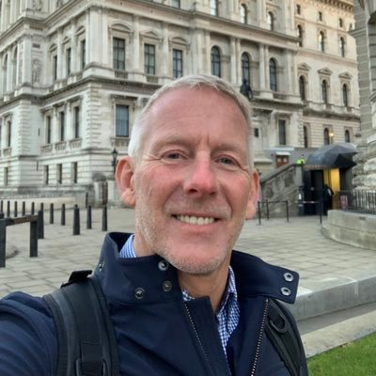
Andy Rhodes
Director of the National Policing Wellbeing Service
#FCNWellFest.

Slide 4
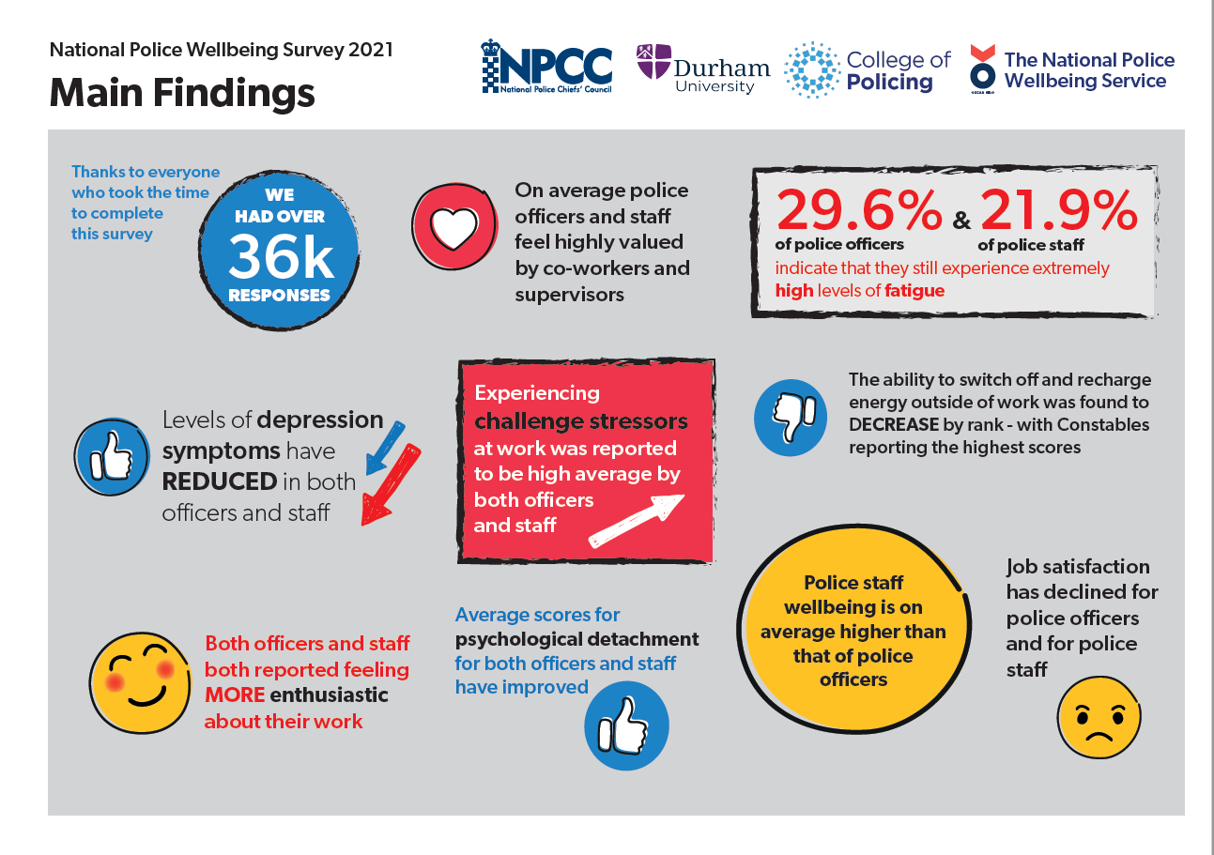

Slide 5
Introduction to the
D/Supt Tim Rowlandson
#FCNWellFest.
Forensic Wellbeing Festival
16 – 20 May 2022
The aim of the Forensic Wellbeing festival is to promote a positive sense of wellbeing for the forensic community across all disciplines and organisations. We aim to educate, challenge, support and empower.

Slide 6
Forensic Wellbeing Festival 16 – 20 May 2022
Monday 16th | 9:45 | Introduction & keynote- Andy Rhodes & Tim Rowlandson
 | 10:30 | FCN Wellbeing Workstream & National Wellbeing Survey results- Paula Mulroy & Jo Morrissey
 | 11:00 | Griffeye presents: Why are investigators traumatised by CSE images? Maariya Arshad
 | 14:00 | Building resilience for employees in trauma exposed roles Dr Noreen Tehrani
Tuesday 17th | 10:00 | Psychological risk assessment- Liz Eades
 | 14:00 | The story of my PTSD – Jo Ward
Wednesday 18th | 10:00 | Anxiety and resilience workshop- Natasha Hill
 | 12:00 | Supporting forensic staff – some ideas to promote and maintain staff wellbeing- Tom Squire
 | 14:00 | Sleep and fatigue- Dr Yvonne Taylor
Thursday 19th | 10:00 | Mindfulness- Natasha Hill
 | 12:00 | BITESIZE: Laughter yoga- Rebecca Gilbody
 | 14:00 | Introduction to Police Care UK- Dave Blundell
Friday 20th | 10:00 | PSNI & Met approach to supporting practitioner wellbeing- Eman Badri & Bob Heuston
 | 12:00 | BITESIZE: Dynamic breathing and cold water therapy- Sam Murray & Miranda Bailey
 | 14:00 | Wellbeing lessons learned from Grenfell- Andrew Langley

Slide 7
FCN Workforce Strategy - Wellbeing Workstream Introduction
Paula Mulroy and Jo Morrissey
#FCNWellFest.

Slide 8
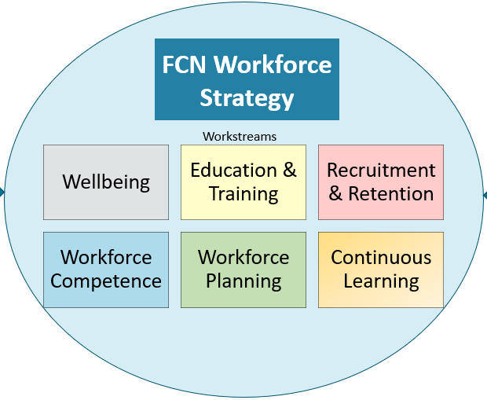
Workforce Strategy
Governance through the Workforce Development & Wellbeing Forum
6 workstreams, 3 have been prioritised
Led by forensic leaders
Clear focus and agreed priorities

Slide 9
Wellbeing Workstream
Workstream Lead: D/Supt Tim Rowlandson- Hampshire
Identified priorities;
Explore methods to understand current wellbeing status and issues within our forensic community
Identify gaps in existing wellbeing support and good practice within forces
Make recommendations for change to enhance wellbeing of forensic practitioners
Current activity;
Research review and recommendations
Commissioned forensic appendix of the National Wellbeing Survey
Forensic Wellbeing Festival
Forensic Wellbeing Toolkit

Slide 10

National Wellbeing Survey, Durham University
Early Forensic Feedback
Full police National Wellbeing Survey 2021 results not due out until May/June
We have received an appendix report and held an analysis meeting with Durham university
784 responses from individuals working within forensic services
Collected over 7 weeks from end Oct 2021
Limitations of the survey
Oscar Kilo
National Wellbeing Survey 2021

Slide 11
National Wellbeing Survey- Early Forensic Feedback
#FCNWellFest.
Positive outcomes
Job Satisfaction 5.21 High
Intention to Quit 3.38 Moderately Low
Life Satisfaction (1-10 scale) 7.02 High
Sense of Being Valued by Co-Workers (0-10 scale) 7.49 High
Sense of Being Valued by Supervisor (0-10 scale) 6.52 Moderately High
Sense of Being Valued by the Force (0-10 scale) 4.82 Moderate
Sense of Being Valued by the Public (0-10 scale) 5.00 Moderate
Experienced Workplace Incivility (past 12 months)
(1-6 scale) 2.20 Low
Sense of Competence at Work (past 3 months) 5.34 High
Prosocial Motivation 5.92 Very High
Work Engagement 5.50 High
Team Belonging 5.64 High
*1-7 scale unless stated otherwise

Slide 12
National Wellbeing Survey- Early Forensic Feedback
#FCNWellFest.
*1-7 scale unless stated otherwise
Areas for improvement
Fatigue (past 2 weeks) 4.72 Moderately High
Symptoms of Anxiety (past 3 months) (1-10 scale) 6.16 Moderately High
Disturbed Sleep (past 3 months) 4.39 Moderately High
Insufficient Sleep (less than 6 hours)
(past 3 months) 4.41 Moderately High
Challenge Stressors (1-5 scale) 3.92 High
Hindrance Stressors (1-5 scale) 3.79 High

Slide 13
National Wellbeing Survey- Early Forensic Feedback
#FCNWellFest.
Comparison across policing
Forensic services is generally one of the lower scoring groups for wellbeing measures (such as emotional energy and fatigue), alongside areas such as response, contact management, CID and custody.
Experienced incivility from co-workers, while nevertheless at a very low level, is perhaps slightly higher than in other areas across policing.
Average scores for measures relating to supervisory leadership (line managers) are generally slightly less positive for respondents from forensic services.
Respondents from forensic services also reported higher frequencies of challenge stressors and in particular hindrance stressors.
Prosocial motivation was reported at a very positive level on average by those in forensic services.

Slide 14
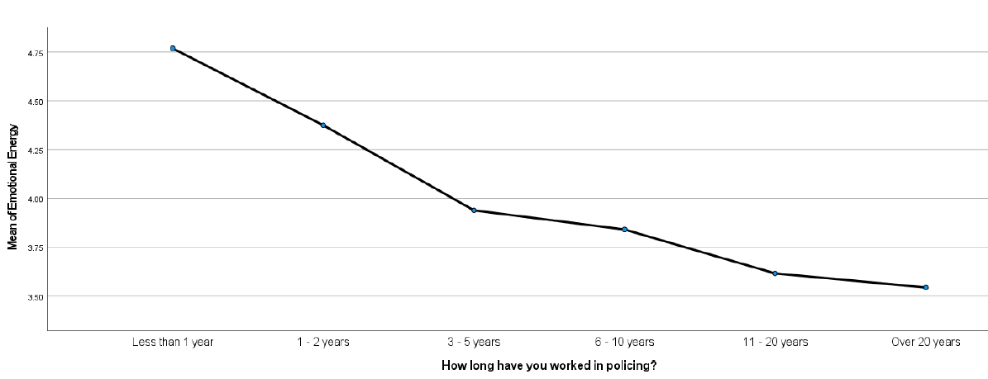
National Wellbeing Survey- Early Forensic Feedback
#FCNWellFest.
Comparison by length of service (Tenure in Policing)
The majority of measures were found to decline across length of service. In particular between the 1-2 years and 3-5 years of service groupings (e.g., fatigue, disturbed sleep, hindrance stressors.
Measures around relatedness need satisfaction and sense of feeling valued appear to drop in particular between the less than 1 year and the 1-2 year groupings, as does frequency of challenge stressors.
.

Slide 15
National Wellbeing Survey- Early Forensic Feedback
#FCNWellFest.
Comparison by age
Average scores on measures generally declined with age. For some key measures (such as emotional energy, fatigue, symptoms of anxiety and depression, perceived organisational support, hindrance stressors, work engagement), the grouping of 36-45 years of age in particular reported lower average scores.
Comparison by grade
As would be expected, autonomy need satisfaction increases with grade
Job satisfaction increases with grade
Psychological detachment is slightly lower for supervisory managers.
Organisational measures such as perceived organisational support and vision clarity (of their force) are also reported more positively at higher grades.
Frequency of experiencing challenge stressors (time pressure, high levels of responsibility) unsurprisingly increase with grade; supervisory managers score particularly high on this measure.
.

Slide 16
National Wellbeing Survey- Early Forensic Feedback
#FCNWellFest.
Comparison of Force regions
Minimal differences were found by regional groupings of forces
Main work location
Those in roles involving working predominantly from home reported higher levels of autonomy need satisfaction, sense of feeling valued by their supervisor and their force, supportive leadership and supervisor listening, vision clarity (of their force), perceived organisational support (from their force), job satisfaction, and engagement in process improvement activity.
Individuals mainly working from home also reported lower frequencies of facing hindrance stressors at work; those working out in the community / face to face with the public scored highest for this measure.
Sense of feeling valued by the public was highest for those working out in the community / face to face with the public, while lower for those working from home.

Slide 17
#FCNWellFest.
What will we do with these results;
Sharing with forensic leaders
We have worked to design the festival to support some of these measures
We will design the Forensic Wellbeing Toolkit with these findings in mind
Early career mentoring?
FCN Workforce Strategy Wellbeing Workstream
Happy for you to get involved in any of the work
Particularly a workshop to develop the wellbeing toolkit 25th May 2-4pm Teams
Any questions?

